Slide 1
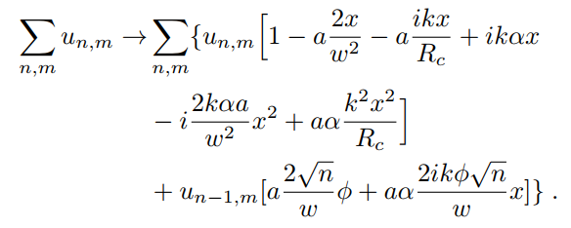
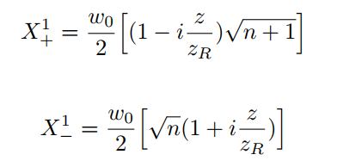
Mathematica
multivariate series expansion
Parse for Python
Split result for coordinate dependence (x,x^2…)
Apply coordinate transformation to HG modes
Long-arm RX TTL Symbolic Solver
1) Solve analytical coupling coefficients
Iterate over modes (n,m) of ‘tophat’
Calculate couplings and split again into modes (x-dep.)
Update mode coefficients (on-axis)
2) Evaluate coupling coefficients
Integrate over PD for on axis modes (n,m) with Gaussian (0,0)
Factor coupling coefficients
Take arg’s for beat signal phases
3) Calculate signals

Slide 2
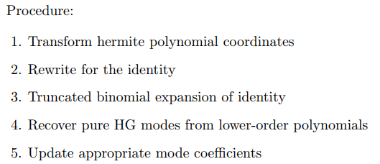




Tophat (Misaligned RX)
Nth order Expansions in tilt and shift

Slide 3
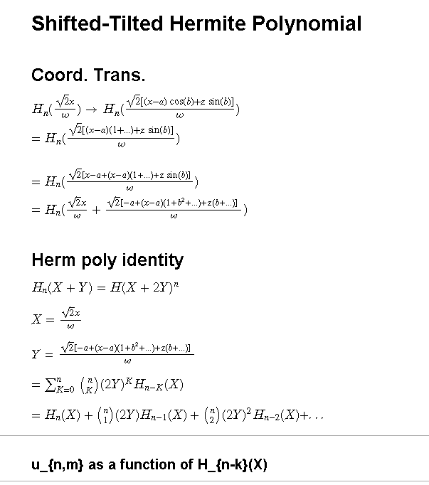

Slide 4
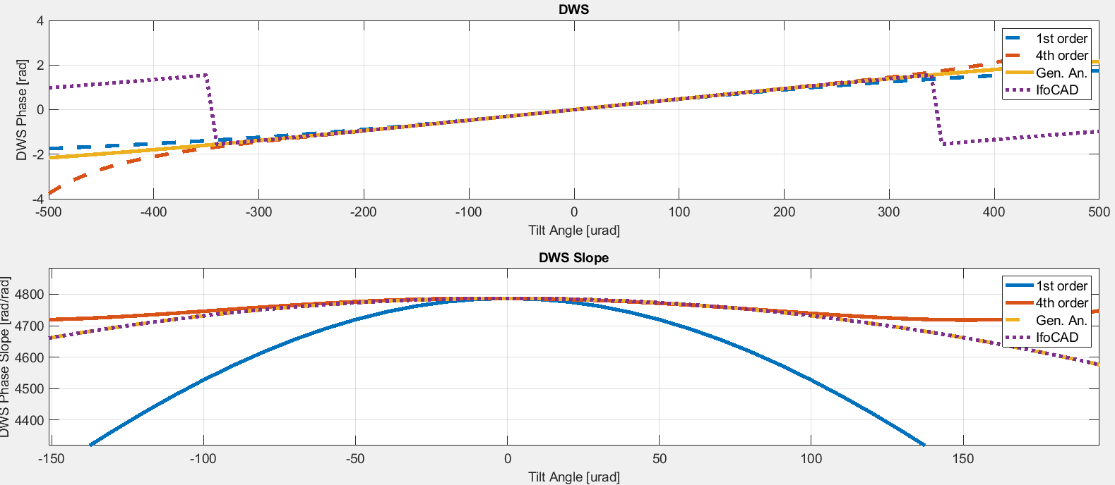

Slide 5
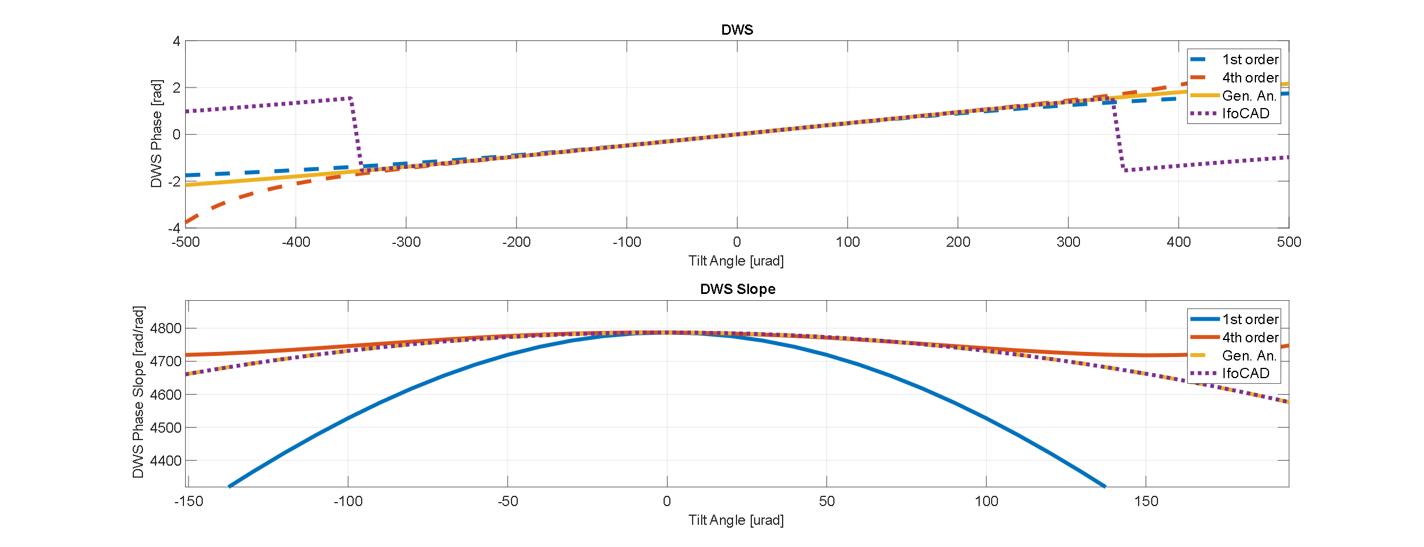

Slide 6
